Slide 1

WELCOME

Slide 2

SIX WEEKS OF TRAINING PROJECT PRESENTATION
BACHELOR OF TECHNOLOGY
IN
AIRTIFICAL INTELLIGENCE AND MACHINE LEARNING
BATCH(2023-2027)
SUBMITTED TO..........................

Slide 3




Certification: ISO 9001:2015 Certified
Specializations:
- Web Development
- Mobile Application Development
- Custom Software Development
- UI/UX Design
- Hosting Services
- Digital Marketing
Services:
- Advanced IT solutions supporting the entire business
- Consulting to system development
- Deployment
- Quality Assurance
- 24x7 Support
Headquarters: Jalandhar
Branch Office: Hoshiarpur
COMPANY
PROFILE

Slide 4
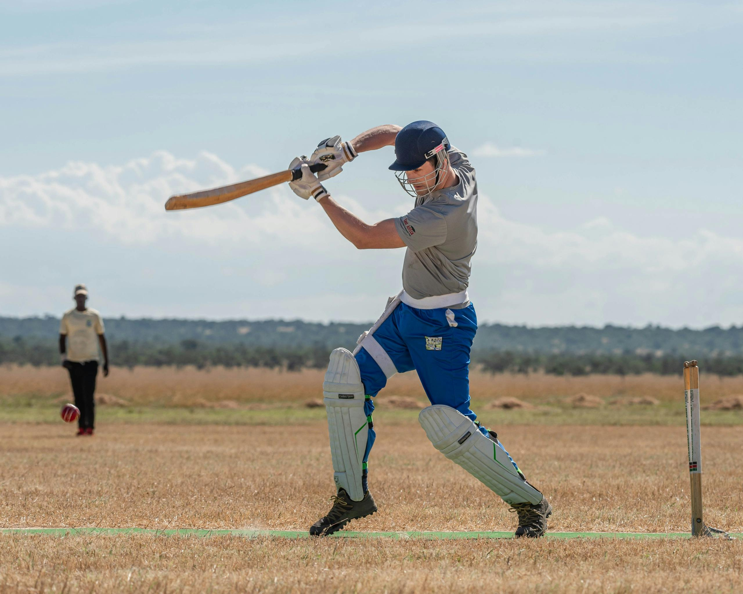

CRICKSTATS
NAME : NISHANT SHARMA CLASS : B.TECH(AI&ML)
ROLL NO. : 12300162

Slide 5
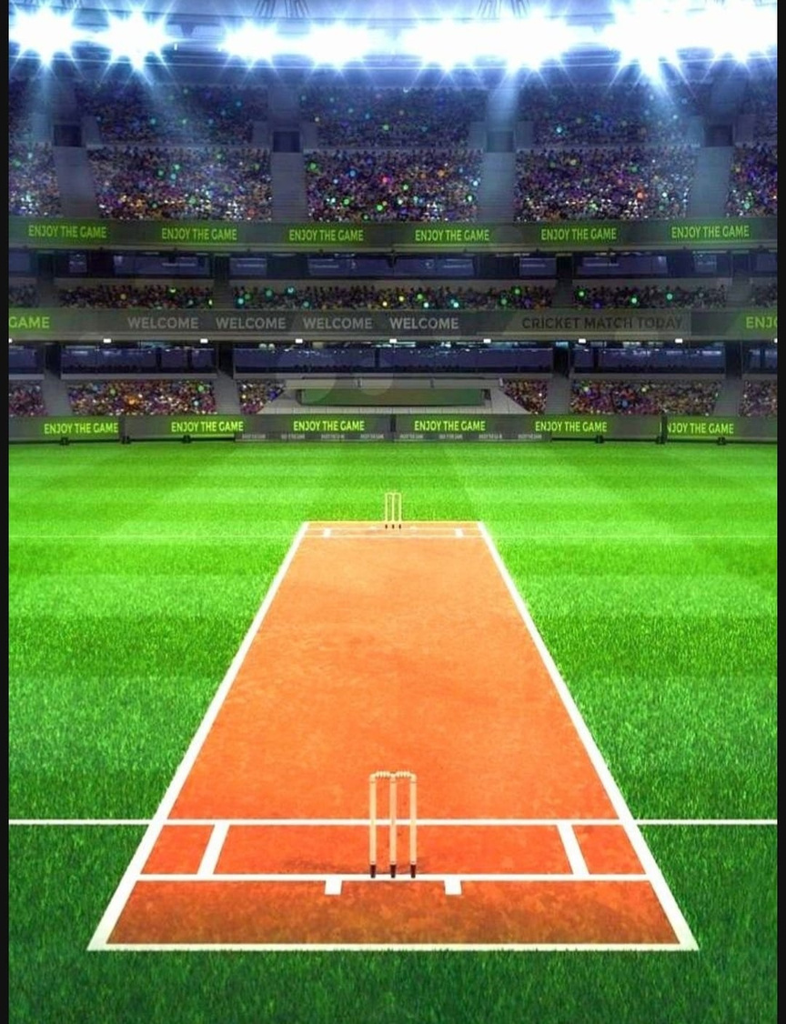
TABLE OF CONTENT
DRAWBACKS
DEFINATION
OBJECTIVES
MODULES
ADVANTAGES
DFDs
REQUIRMENTS
TECHNOLOGY USED
SCREENSHOTS
C0NCLUSION
FUTURE SCOPE
THANK YOU

Slide 6


DRAWBACKS
No live match data
Shows only basic stats
Not easy to use
Can’t search as needed
Misses small/local matches
Some data is wrong

Slide 7
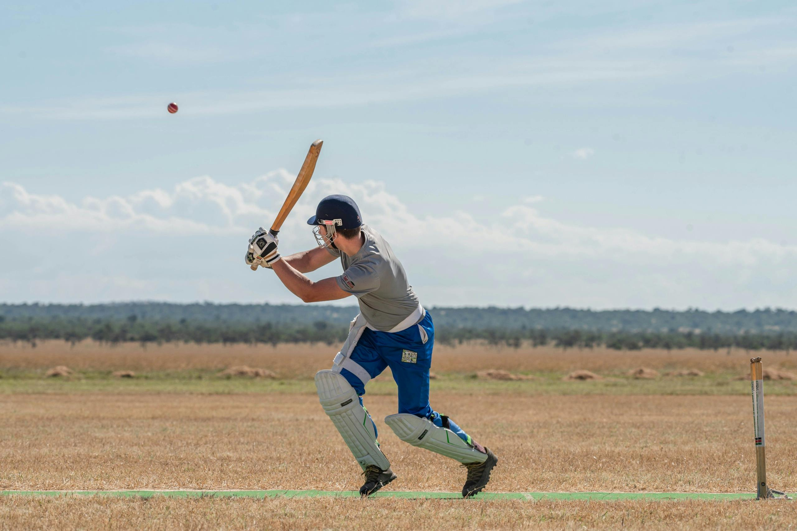
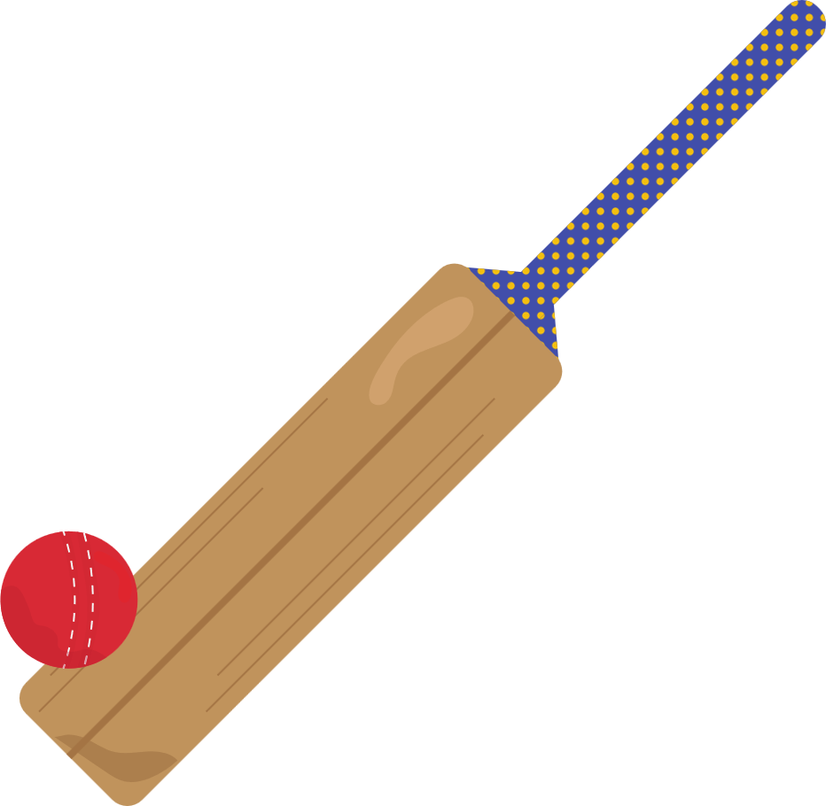
CRICKSTATS
CrickStat is a project or tool that collects, analyzes, and shows data about cricket matches, players, and teams. It helps people understand cricket better using numbers, charts, and stats.

Slide 8
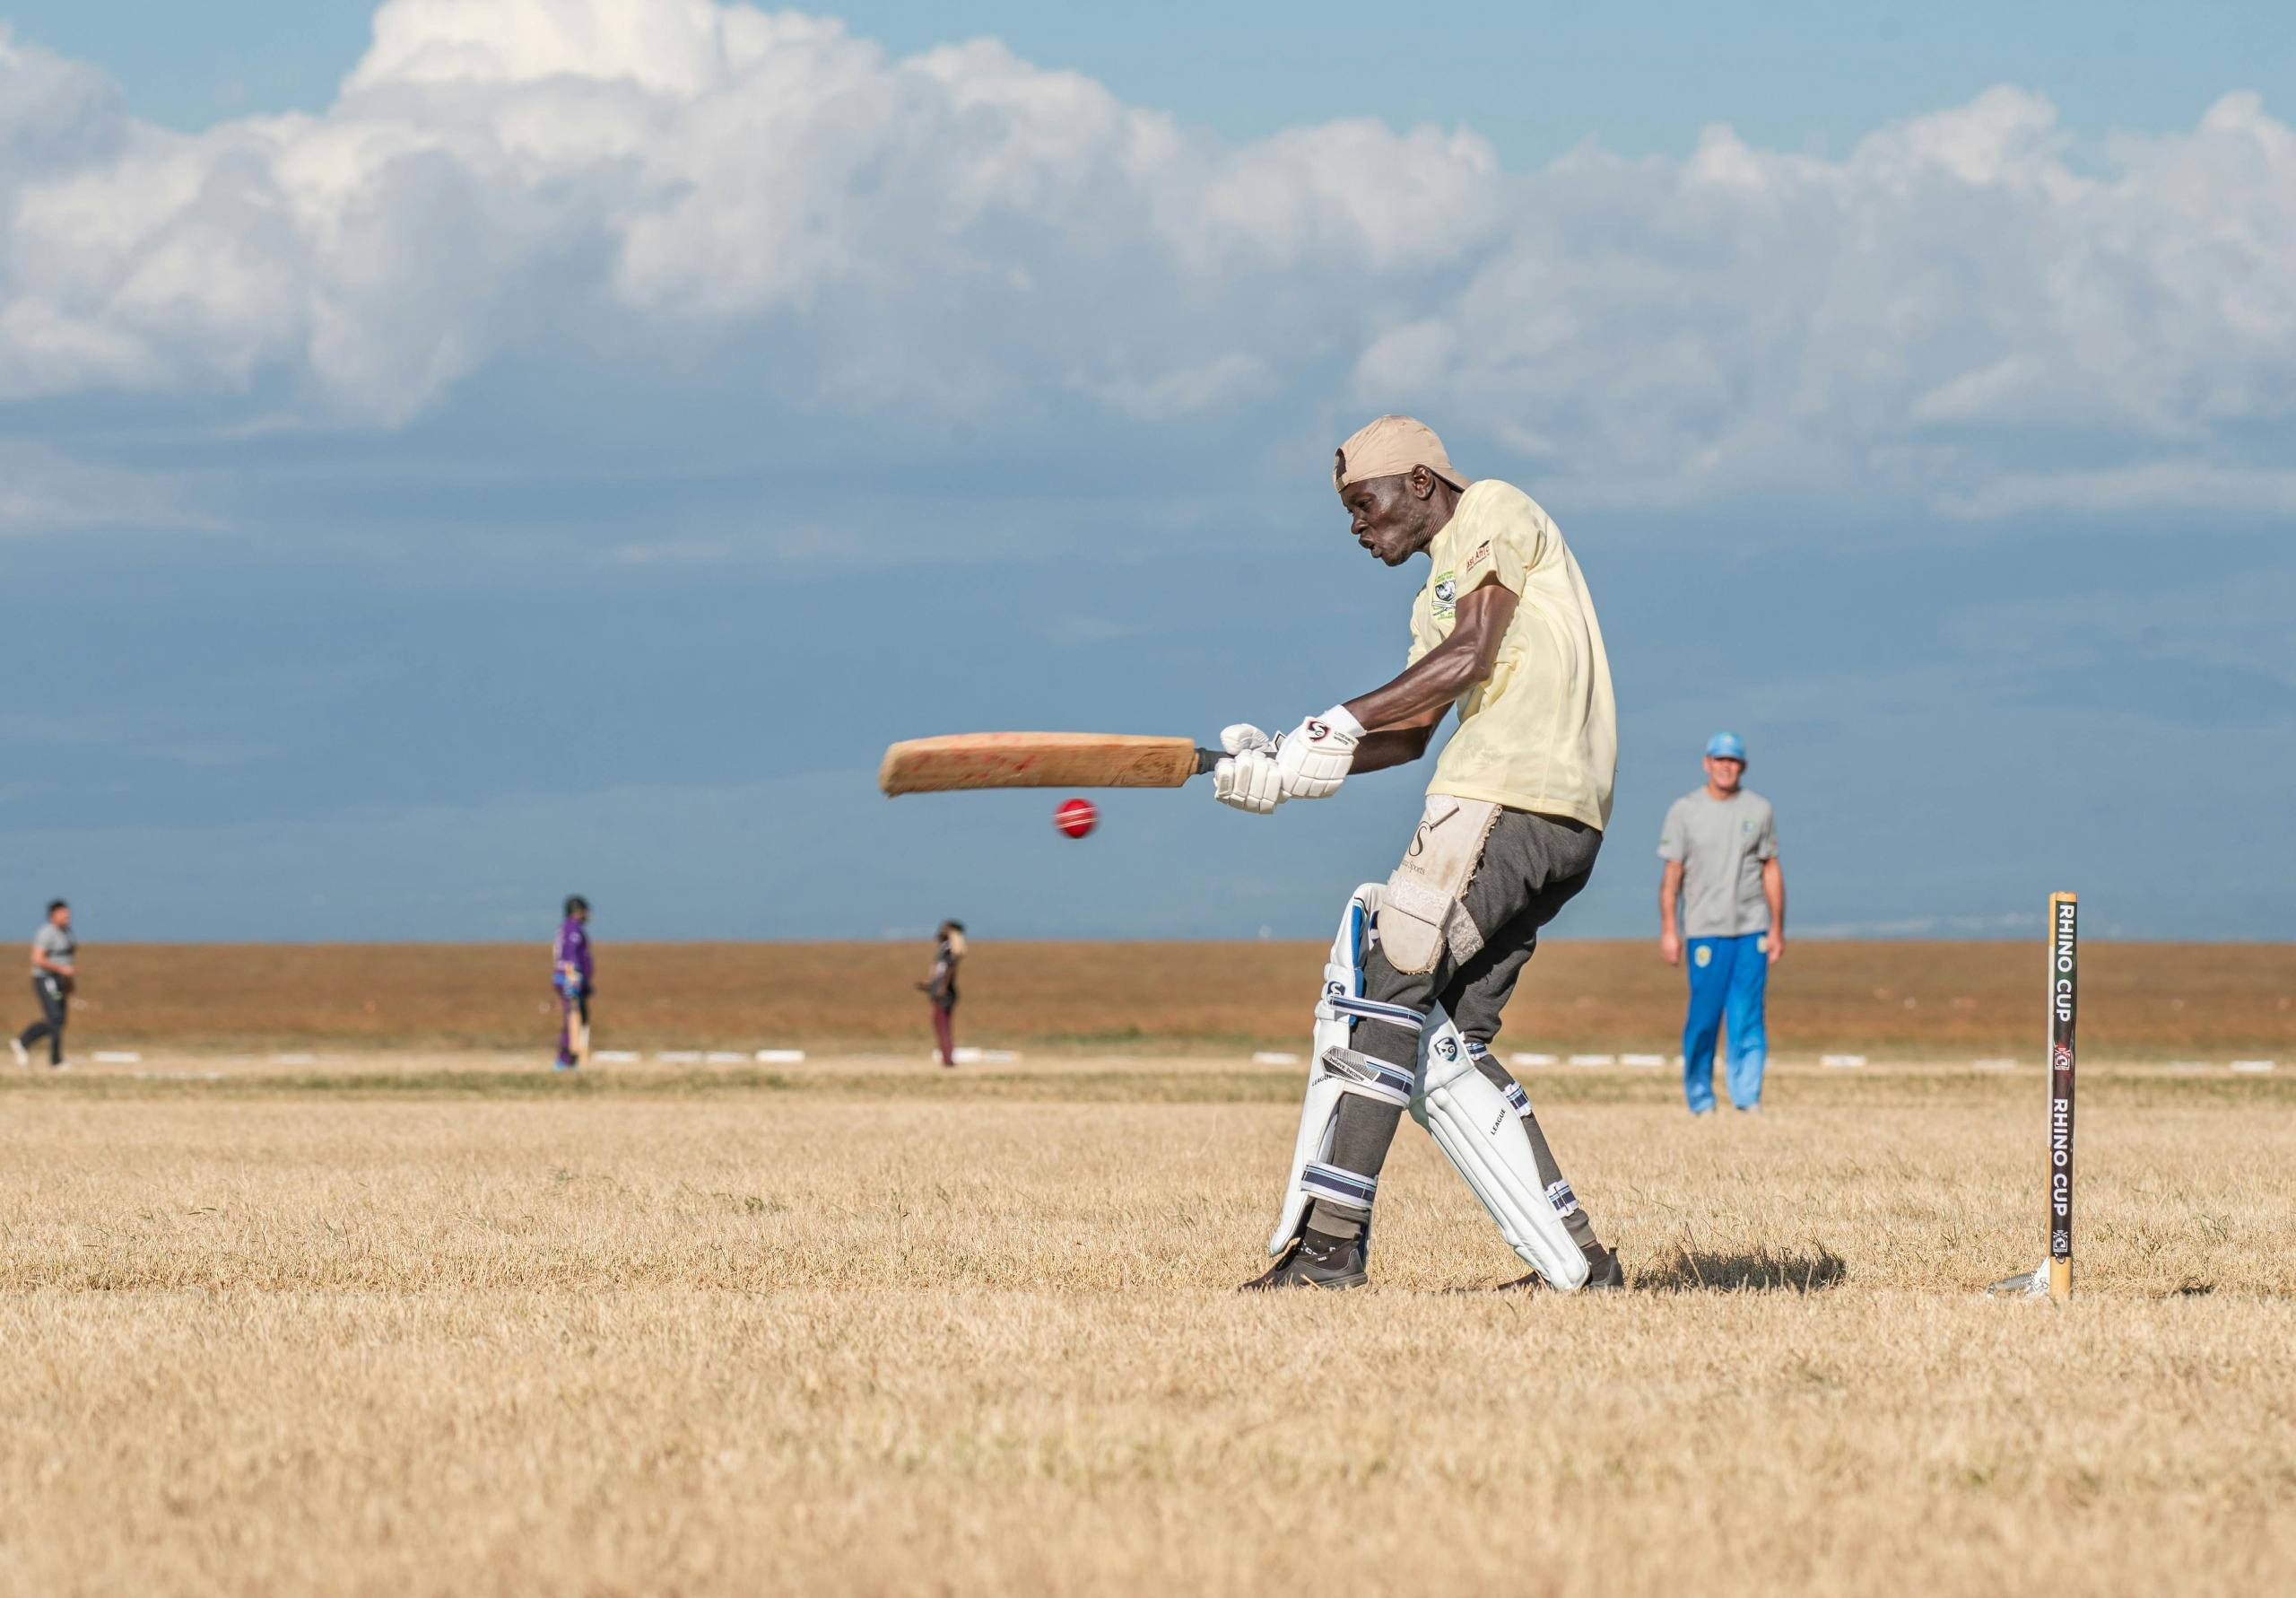
To study and understand cricket data (like runs, wickets, scores)
To find top players and best teams using statistics.
To show cricket stats using simple charts and graphs.
To compare matches and team performances.
OBJECTIVES

Slide 9


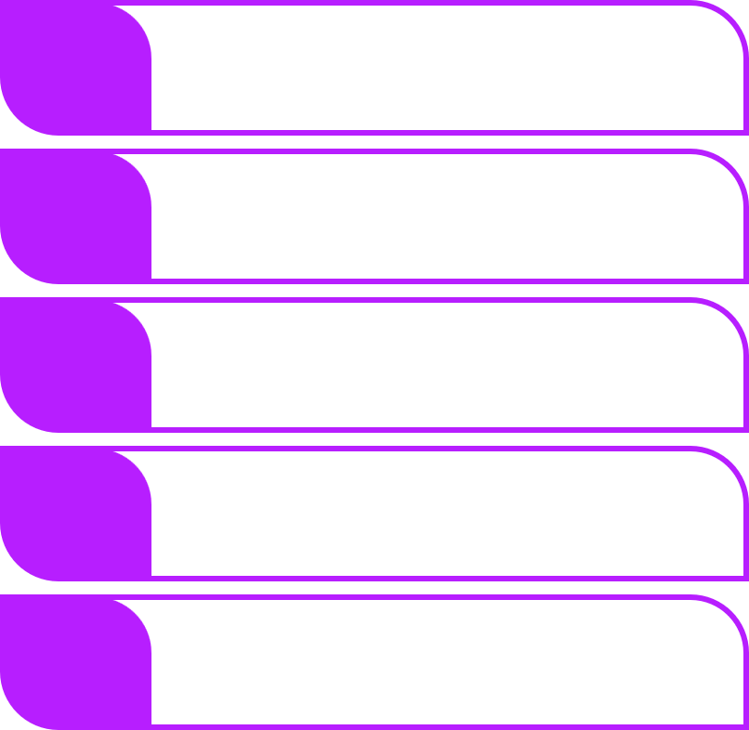

MODULES
1.
DATA COLLECTION
2.
DATA CLEANING
3.
DATA ANALYSIS
4.
VISUALIZATION
5.
INSIGHT GENERATION

Slide 10

ADVANTAGES
Helps understand player performance
Makes match analysis easy
Helps in planning strategies
Useful for predicting future performance
Increases fan engagement and interest

Slide 11
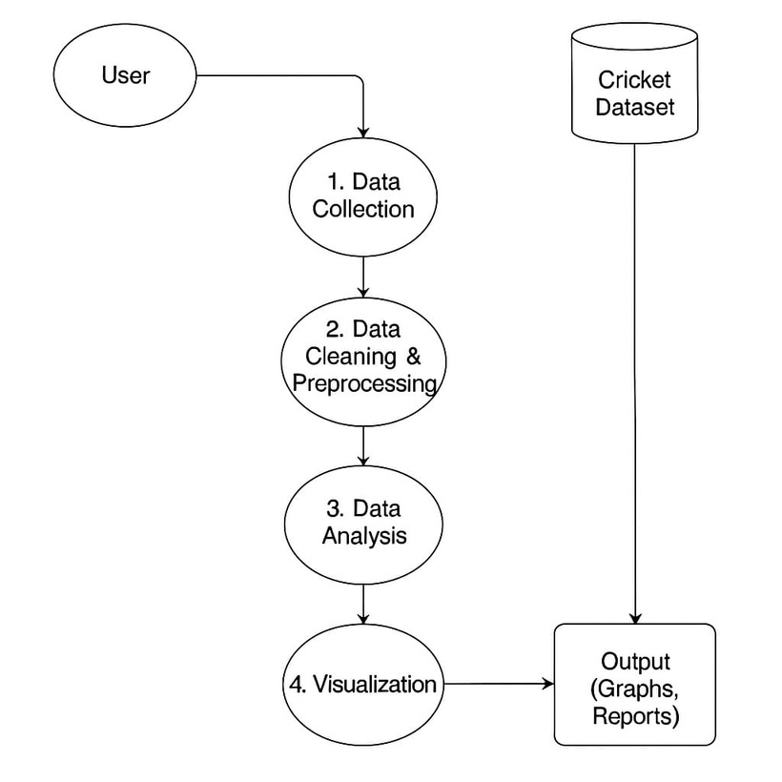
DFD

Slide 12
REQUIRMENTS
SOFTWARE REQUIRMENTS
HARDWARE REQUIRMENT
Python(for data analysis)
Pandas,Numpy(data handling)
Matplotlip/Seaborn(chart)
Processor: Intel i5
RAM: 8 GB
SSD Storage

Slide 13


TECHNOLOGY
USED....

Slide 14


MAIN TECHNOLOGY: PYTHON
Python is a high-level, general-purpose, interpreted programming language known for its readability and versatility. It's widely used in web development, data science, machine learning.
Why used?
To write code that processes and analyzes cricket match statistics, player data, and performance trends.

Slide 15



PANDA’S
Pandas is an open-source Python library used to store, organize, and analyze data in table format.
Pandas is a Python tool used to handle cricket data.
It helps to store, manage, and analyze data easily.
We can find top scorers, averages, and total runs/wickets.
Data from Excel or CSV files can be used.

Slide 16
SEABORN
Seaborn is a Python data visualization library built on top of Matplotlib.
Seaborn is a Python tool used to make charts and graphs.
It helps us to see cricket data in a visual way.
Works well with Pandas data.

Slide 17
SCREENSHOTS

Slide 18
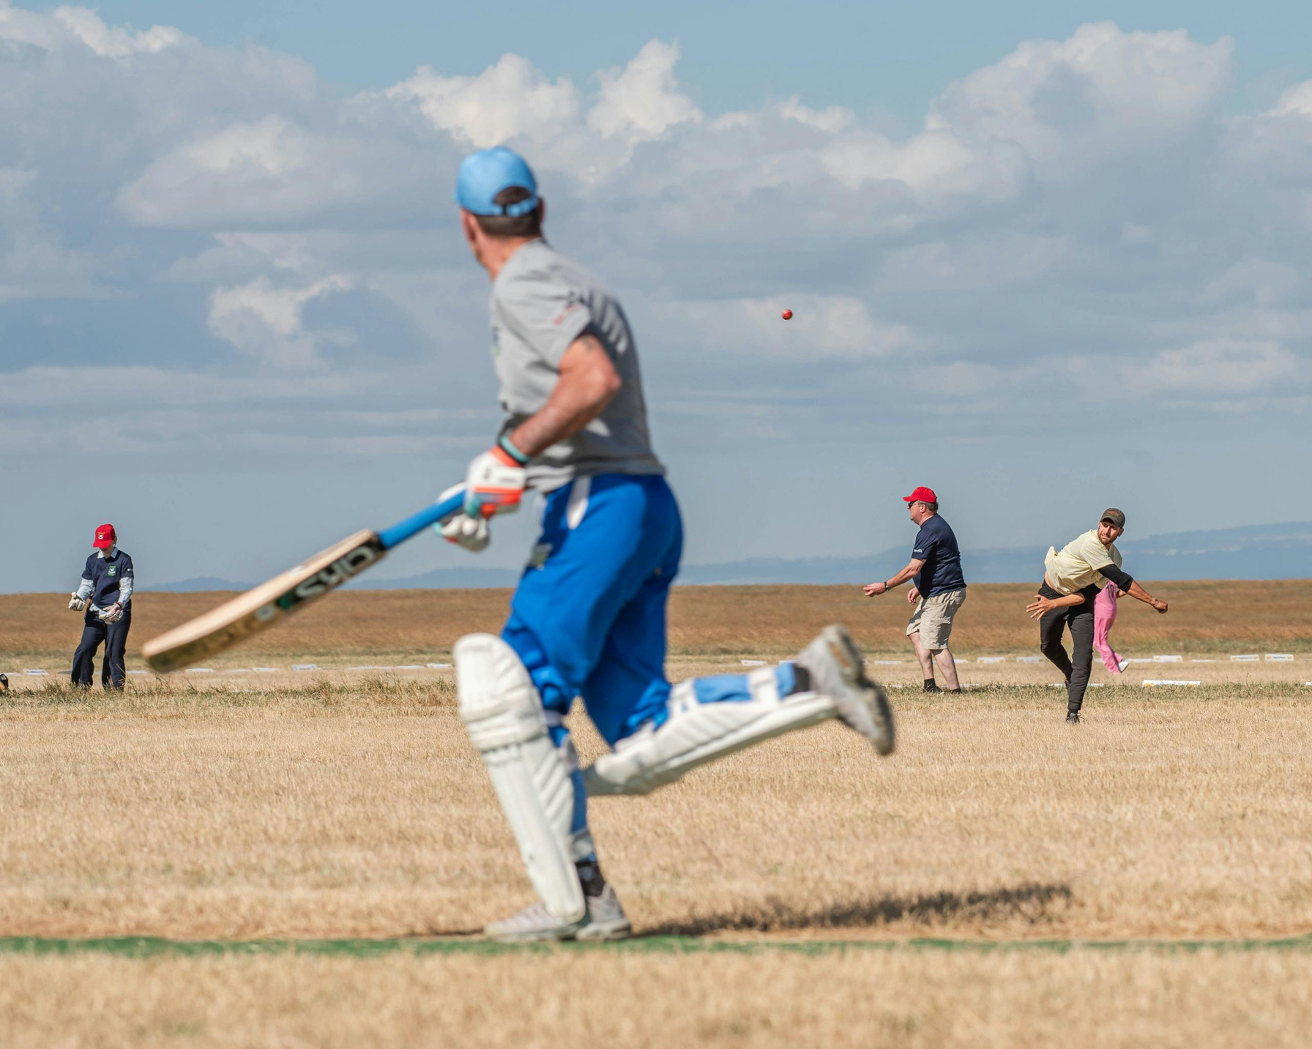
CONCLUSION
In this project, we studied cricket using real match data.
We looked at how players and teams performed in different matches.
We used charts and graphs to make the data easy to understand.
This helped us find interesting facts like who scores the most runs or which team wins more match

Slide 19

FUTURE SCOPE
Show live match data
Guess how players will play
Help teams plan better
Make cricket apps more fun
Support local and women’s cricket

Slide 20


